Slide 1

Object Oriented Software Engineering
Lecture 7

Slide 2
Today’s Outline:
Software Requirement Specifications

Slide 3
Define
SRS is a description of a software system to be developed.
It lays out functional and non-functional requirements of the software to be developed.
It may include a set of use cases that describes the user interaction.

Slide 4
What is SRS?
A software requirements specification (SRS) is a document that describes what the software will do and how it will be expected to perform. It also describes the functionality the product needs to fulfill all stakeholders (business, users) needs.
A typical SRS includes:
A purpose
An overall description
Specific requirements
The best SRS documents define how the software will interact when embedded in hardware — or when connected to other software. Good SRS documents also account for real-life users.

Slide 5
Software Requirement Specification
The production of the requirements stage of the software development process is Software Requirements Specifications (SRS) (also called a requirements document). This report lays a foundation for software engineering activities and is constructing when entire requirements are elicited and analyzed. SRS is a formal report, which acts as a representation of software that enables the customers to review whether it (SRS) is according to their requirements. Also, it comprises user requirements for a system as well as detailed specifications of the system requirements.

Slide 6
Why Use an SRS Document?
A software requirements specification is the basis for your entire project. It lays the framework that every team involved in development will follow.
It’s used to provide critical information to multiple teams — development, quality assurance, operations, and maintenance. This keeps everyone on the same page.
Using the SRS helps to ensure requirements are fulfilled. And it can also help you make decisions about your product’s lifecycle — for instance, when to retire a feature.
Writing an SRS can also minimize overall development time and costs. Embedded development teams especially benefit from using an SRS.

Slide 7
Software Requirements Specification vs. System Requirements Specification
A software requirements specification (SRS) includes in-depth descriptions of the software that will be developed.
A system requirements specification (SyRS) collects information on the requirements for a system.

Slide 8
What does an SRS document contain?
A typical SRS document describes all the software requirements and sometimes even contains a collection of use cases that describe the user interactions needed by the software.
It defines the purpose of a software project, provides the overall definition and specifications of its features.
In general, SRS documents contain three kinds of program requirements:
Functional specifications that include measures to be performed by the system
Non-functional requirements determining the software system’s performance attributes
Domain requirements that are device limits on the service domain

Slide 9
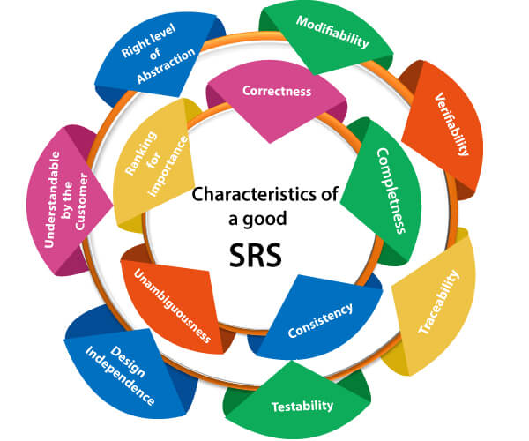
Characteristics of good SRS

Slide 10
Properties of a good SRS document
The essential properties of a good SRS document are the following:
Concise: The SRS report should be concise and at the same time, unambiguous, consistent, and complete. Verbose and irrelevant descriptions decrease readability and also increase error possibilities.
Structured: It should be well-structured. A well-structured document is simple to understand and modify. In practice, the SRS document undergoes several revisions to cope up with the user requirements.

Slide 11
Properties of a good SRS document
3. Black-box view: It should only define what the system should do and refrain from stating how to do these. This means that the SRS document should define the external behavior of the system and not discuss the implementation issues.
4. Conceptual integrity: It should show conceptual integrity so that the reader can merely understand it. Response to undesired events: It should characterize acceptable responses to unwanted events. These are called system response to exceptional conditions.
5. Verifiable: All requirements of the system, as documented in the SRS document, should be correct. This means that it should be possible to decide whether or not requirements have been met in an implementation.

Slide 12
Example-SRS of Hospital Mgt. System
Software
Hardware
O.S: Window XP or Higher
App S/w: MS-Office ver 2003 or higher
Desiging S/W: Coraldraw 9 or Higher
HDD: 1 TB or Higher (Segate)
RAM: 8GB or Higher
Processor: i5/i7

Slide 13
Thank You

